Slide 1
Introduction to PaaS/SaaS

Slide 2


Slide 3













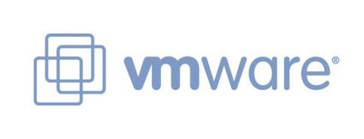




Commercial Cloud Formation

Slide 4
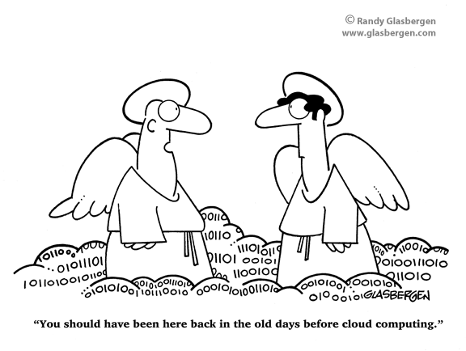

Slide 5














Perspectives
Utility Computing
Platform as a Service (PaaS)
Cloud-based User Applications

Slide 6
Cloud Computing-What is it?
moving services, computation and to an internal or external, centralized facility or contractor.
Reason
easy and ubiquitous accessibility
cost
collaboration, integration, and analysis on a shared common platform.

Slide 7




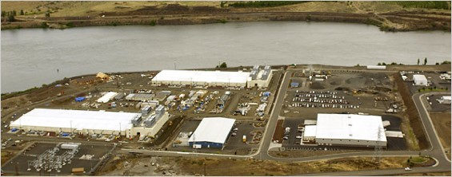
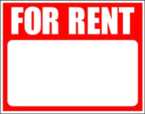
What is it?
SLAs
Web Services
Virtualization

Slide 8
What is it?
SaaS (software-as-a-service). WAN-enabled application services (e.g., Google Apps, Salesforce.com, WebEx)
PaaS (platform-as-a-service). Foundational elements to develop new applications (e.g., Coghead, Google Application Engine)
IaaS (infrastructure-as-a-service). Providing computational and storage infrastructure in a centralized, location-transparent service (e.g., Amazon)

Slide 9
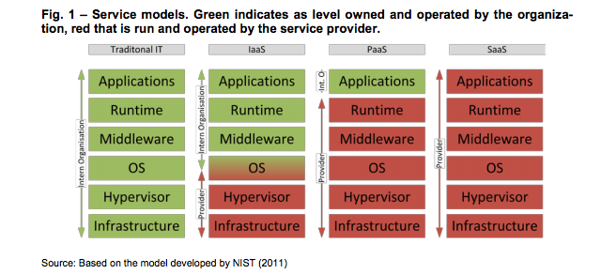
What is it?
Green indicates the levels owned and operated by the organization
Red levels are run and operated by the service provider

Slide 10
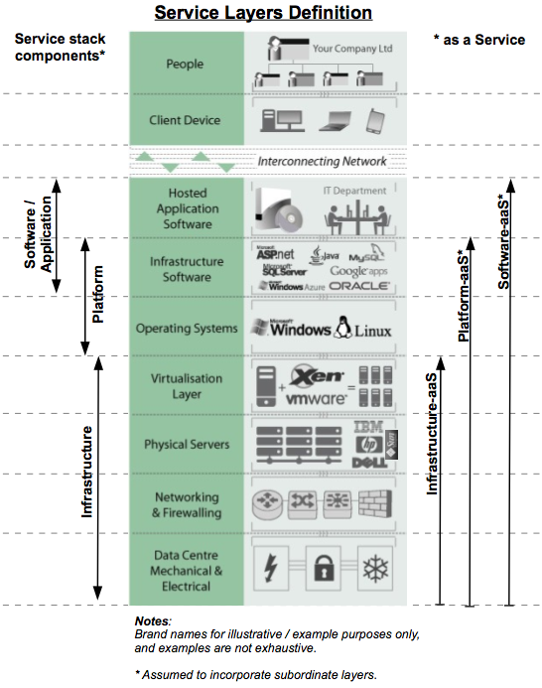
Source: http://www.katescomment.com/iaas-paas-saas-definition/

Slide 11
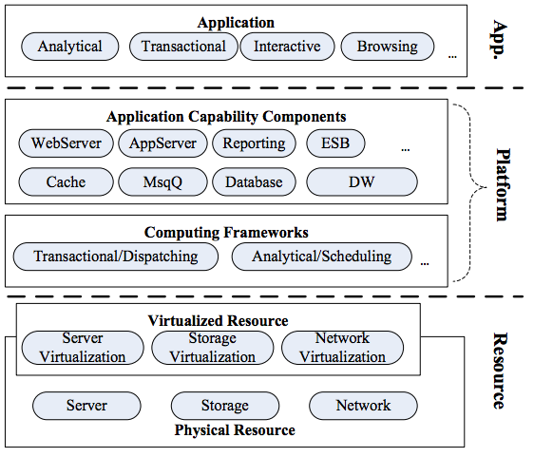
Core Stacks
Source: Goel, Pragati, and Mayank Kumar. "An overview of Cloud Computing."

Slide 12
Resource Layer
infrastructure layer which is composed of physical and virtualized computing, storage and networking resources.
Platform Layer
computing framework manages the transaction dispatching and task scheduling.
storage sub-layer provides storage and caching capability
Application Layer
general application logic
either on-demand capability or flexible management.
no components will be the bottle neck of the whole system.
large and distributed transactions and management of huge volume of data.
All the layers provide external service through web service or other open interfaces.

Slide 13
Introduction to PaaS

Slide 14
What is a Platform?
A platform is anything you can leverage to accomplish something in a simpler, faster, or otherwise better way than you could without.
As a programmer, you leverage pre-existing code rather than starting from scratch and writing everything.
The most well-known software platforms for desktop software are Windows and Mac OS

Slide 15
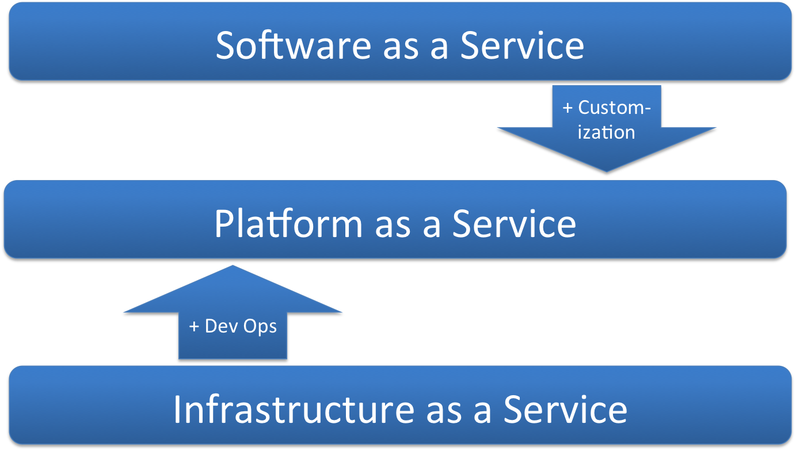
Platform as a Service (PaaS)

Slide 16
Web Platforms
the infrastructure or hosting layer is analogous to desktop computer hardware and the platform layer is analogous to a desktop operating system.
Additional features such as email distribution lists, contact form handlers, e-commerce options and other tools that make it easier to build and run a website are part of almost every hosting service,

Slide 17
Goals of PaaS
The ultimate goal of a PaaS is to make it easier for you to run your website or web application no matter how much traffic it gets.
You just deploy your application and the service figures out what to do with it.
A platform as a service should handle scaling seamlessly for you so you can just focus on your website and the code running it.

Slide 18
Why PaaS?
There is always a conflict between the developers and the System Engineers
Developers are keen on getting their environments up without waiting.
System Engineers care about performance and stability
Creates a peaceful environment for both parties

Slide 19
OpenShift
The open source PaaS from RedHat
OpenShift runs on top of OpenStack
Companies can deploy OpenShift on top of their infrastructure
OpenStack is the infrastructure and OpenShift is the platform that run on top of it
This analogous to Apache and MySQL that run on top of a Linux machine

Slide 20
OpenShift Example
What is a cartridge?
OpenShift offers cartridges to deploy on to Red Hat’s infrastructure
Sign up for OpenShift
Create your own namespace
Deploy Apps
Sample cartridges – Java, PHP, Ruby, Python
Framework support- CakePHP, CodeIgniter

Slide 21
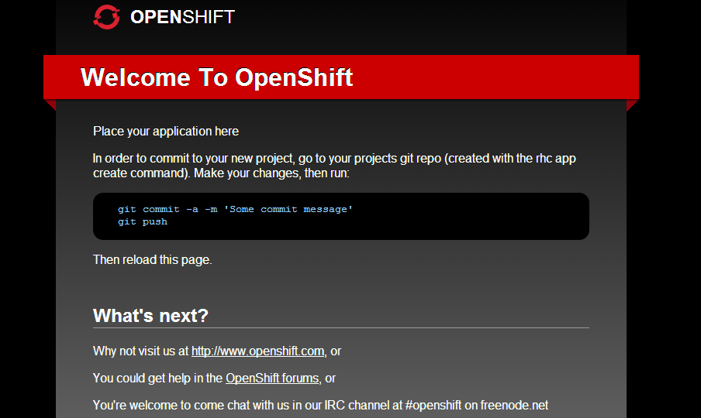
OpenShift PHP Cartridge

Slide 22
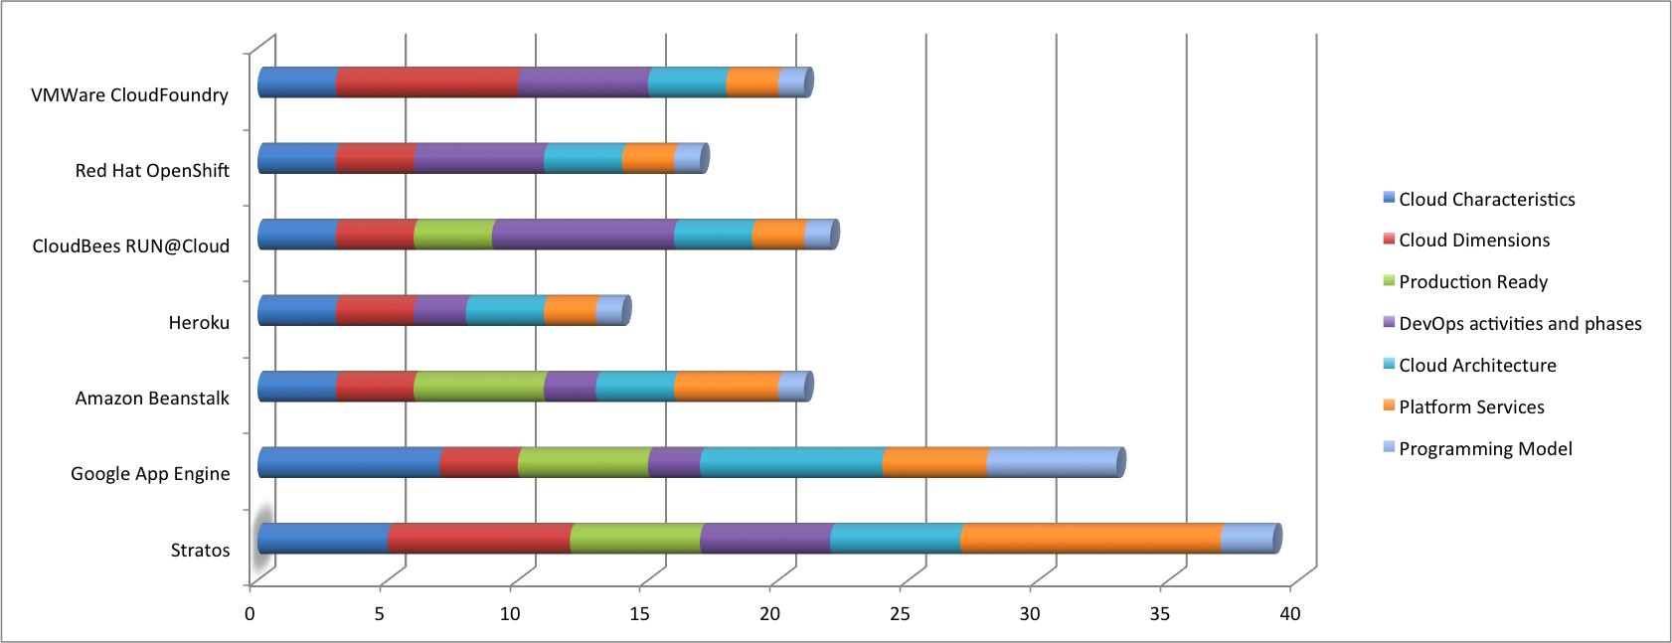
Platform Comparison
 | Stratos | Google App Engine | Amazon Beanstalk | Heroku | CloudBees RUN@Cloud | Red Hat OpenShift | VMWare CloudFoundry
Cloud Characteristics | 5 | 7 | 3 | 3 | 3 | 3 | 3
Cloud Dimensions | 7 | 3 | 3 | 3 | 3 | 3 | 7
Production Ready | 5 | 5 | 5 | 0 | 3 | 0 | 0
DevOps activities and phases | 5 | 2 | 2 | 2 | 7 | 5 | 5
Cloud Architecture | 5 | 7 | 3 | 3 | 3 | 3 | 3
Platform Services | 10 | 4 | 4 | 2 | 2 | 2 | 2
Programming Model | 2 | 5 | 1 | 1 | 1 | 1 | 1
Notes:
See blog post: http://blog.cobia.net/cobiacomm/2011/11/02/paas-evaluation-framework-for-cios-and-architects/

Slide 23
SaaS Definition
Software as Service is a software delivery model in which software and data are hosted centrally and accessed via web. It can be rented .
Configuration and customization
according to the customer
Accelerated feature delivery
weekly updates
Multi tenant architecture
single instance of the software for multiple client organizations
Open integration protocols
API’S and protocols for accessing company’s internal systems

Slide 24
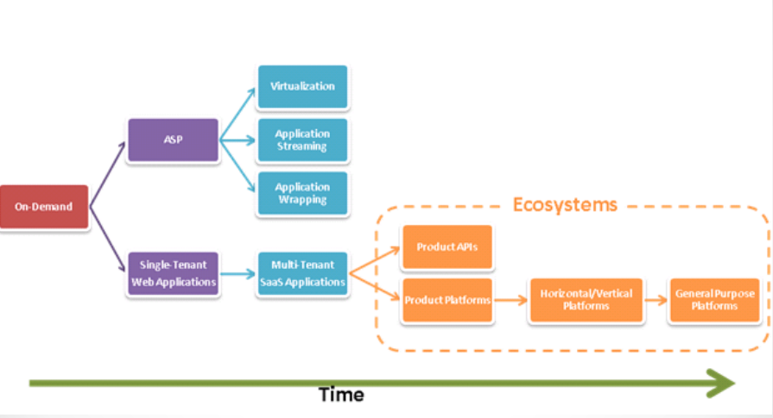
A Brief History
1960-IBM and other main frame providers came up with time sharing or utility computing services.
1990- ASP with advent of internet
2000- Increased speed of internet resulted in more popularity of SaaS

Slide 25
ADVANTAGES
USER BENEFITS:
Lower Cost of Ownership
Focus on Core Competency .
Access Anywhere
Freedom to Choose (or Better Software)
Faster Product Cycles
VENDOR BENEFITS:
.Increased Total Available Market
. Lower Development Costs & Quicker Time-to-Market
. Improved Customer Relationships

Slide 26
Applicability and types of SaaS
Enterprise Software application:
Sharing of data between internal and external users e.g. : Salesforce CRM application
Single user Software application
Runs on single user computer and serves 1 user at a time e.g. : Microsoft office
Business Utility SaaS - Applications like Salesforce automation are used by businesses and individuals for managing and collecting data, streamlining collaborative processes and providing actionable analysis. Popular use cases are Customer Relationship Management (CRM), Human Resources and Accounting.
Social Networking SaaS - Applications like Facebook are used by individuals for networking and sharing information, photos, videos, etc.

Slide 27
Important factors for a good design
Three key differentiators that separate well-designed SaaS application from a poorly designed one
scalability
Multi tenant efficient
configurable
Scaling the application - maximizing concurrency, and efficient use of resources
i.e. optimizing locking duration, statelessness, sharing pooled resources such as threads and network connections, caching reference data, and partitioning large databases

Slide 28
Multi-tenancy – important architectural shift from designing isolated, single-tenant applications
One application instance should accommodate users from multiple other companies at the same time while providing transparency
This requires an architecture that maximizes the sharing of resources efficiently across tenants

Slide 29
Configurable - a single application instance on a single server has to accommodate users from several different companies
Customizing the application for one customer will change the application for other customers as well.
Traditionally customizing an application would mean changes in the code.
Each customer must use metadata to configure the way the application appears and behaves for its users.
Customers configuring applications must be simple and easy without any extra development or operation costs

Slide 30
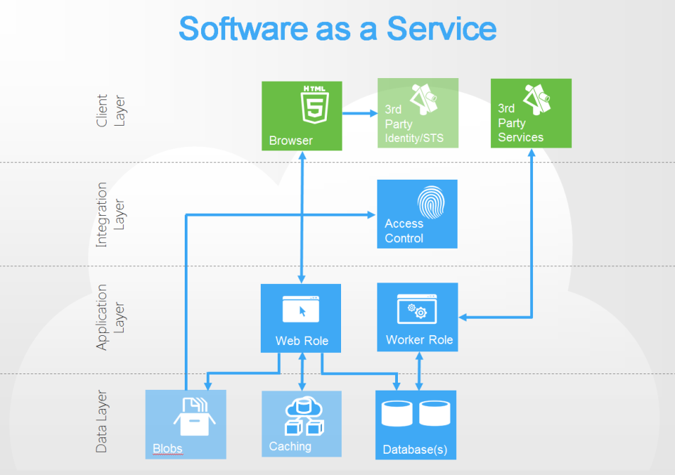
Windows Azure

Slide 31
Azure Architecture
Web role
One for each instance of software
Access control
Definition of users, groups and roles. A pre-built ASP.NET membership provider is included in the training kit.
Databases
Relational database for core operational data
Worker role
Autonomous background processing like billing
Caching
frequently used read-only, user specific, and application resource data in a high-speed distributed in-memory for faster response
Blobs
Blob storage provides a scalable, resilient way to store terabytes of user data

Slide 32
SaaS Drawbacks
Robustness
Difference between Google docs and Microsoft office.
Privacy
Storing all data in cloud prone to hacks
Reliability
Recovery during server downtime is difficult

Slide 33
References
Creeger, M. (2009). Cloud computing: An overview. ACM Queue, 7(5), 3-4.
OpenShift – www.openshift.com
http://www.slideshare.net/cobiacomm/introduction-topaa-s
http://www.ibm.com/developerworks/training/kp/cl-kp-cloudsaas/

